Slide 1

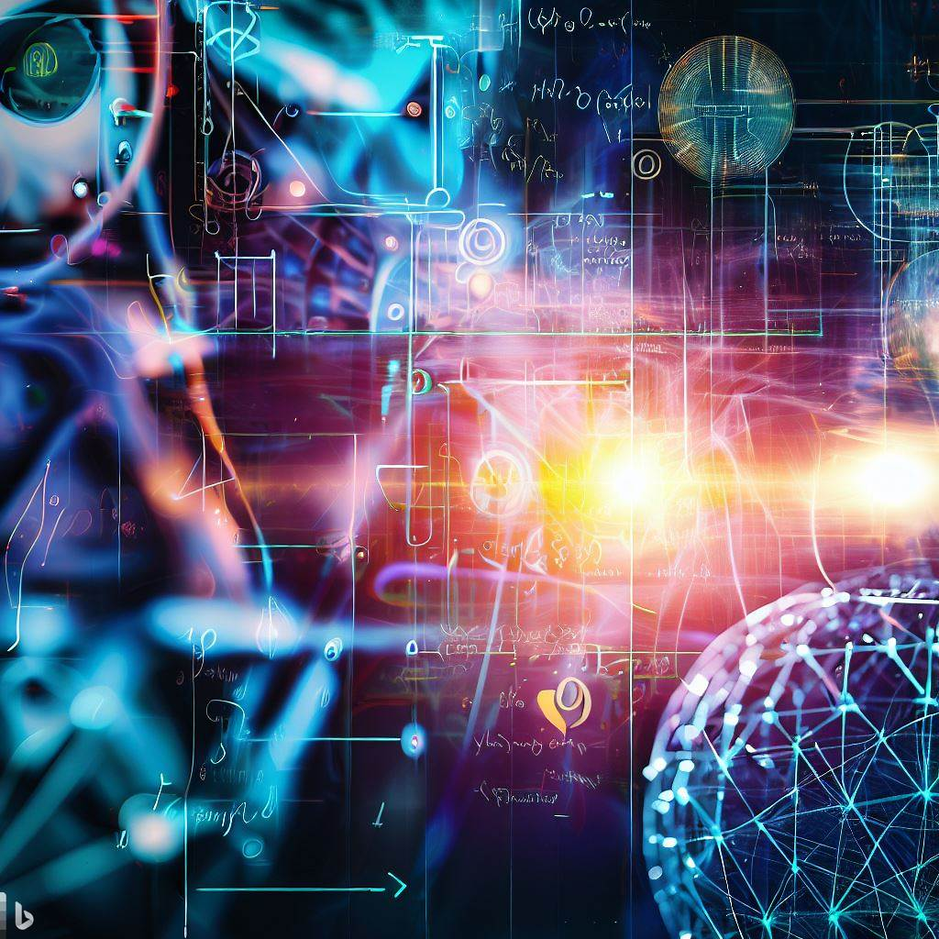
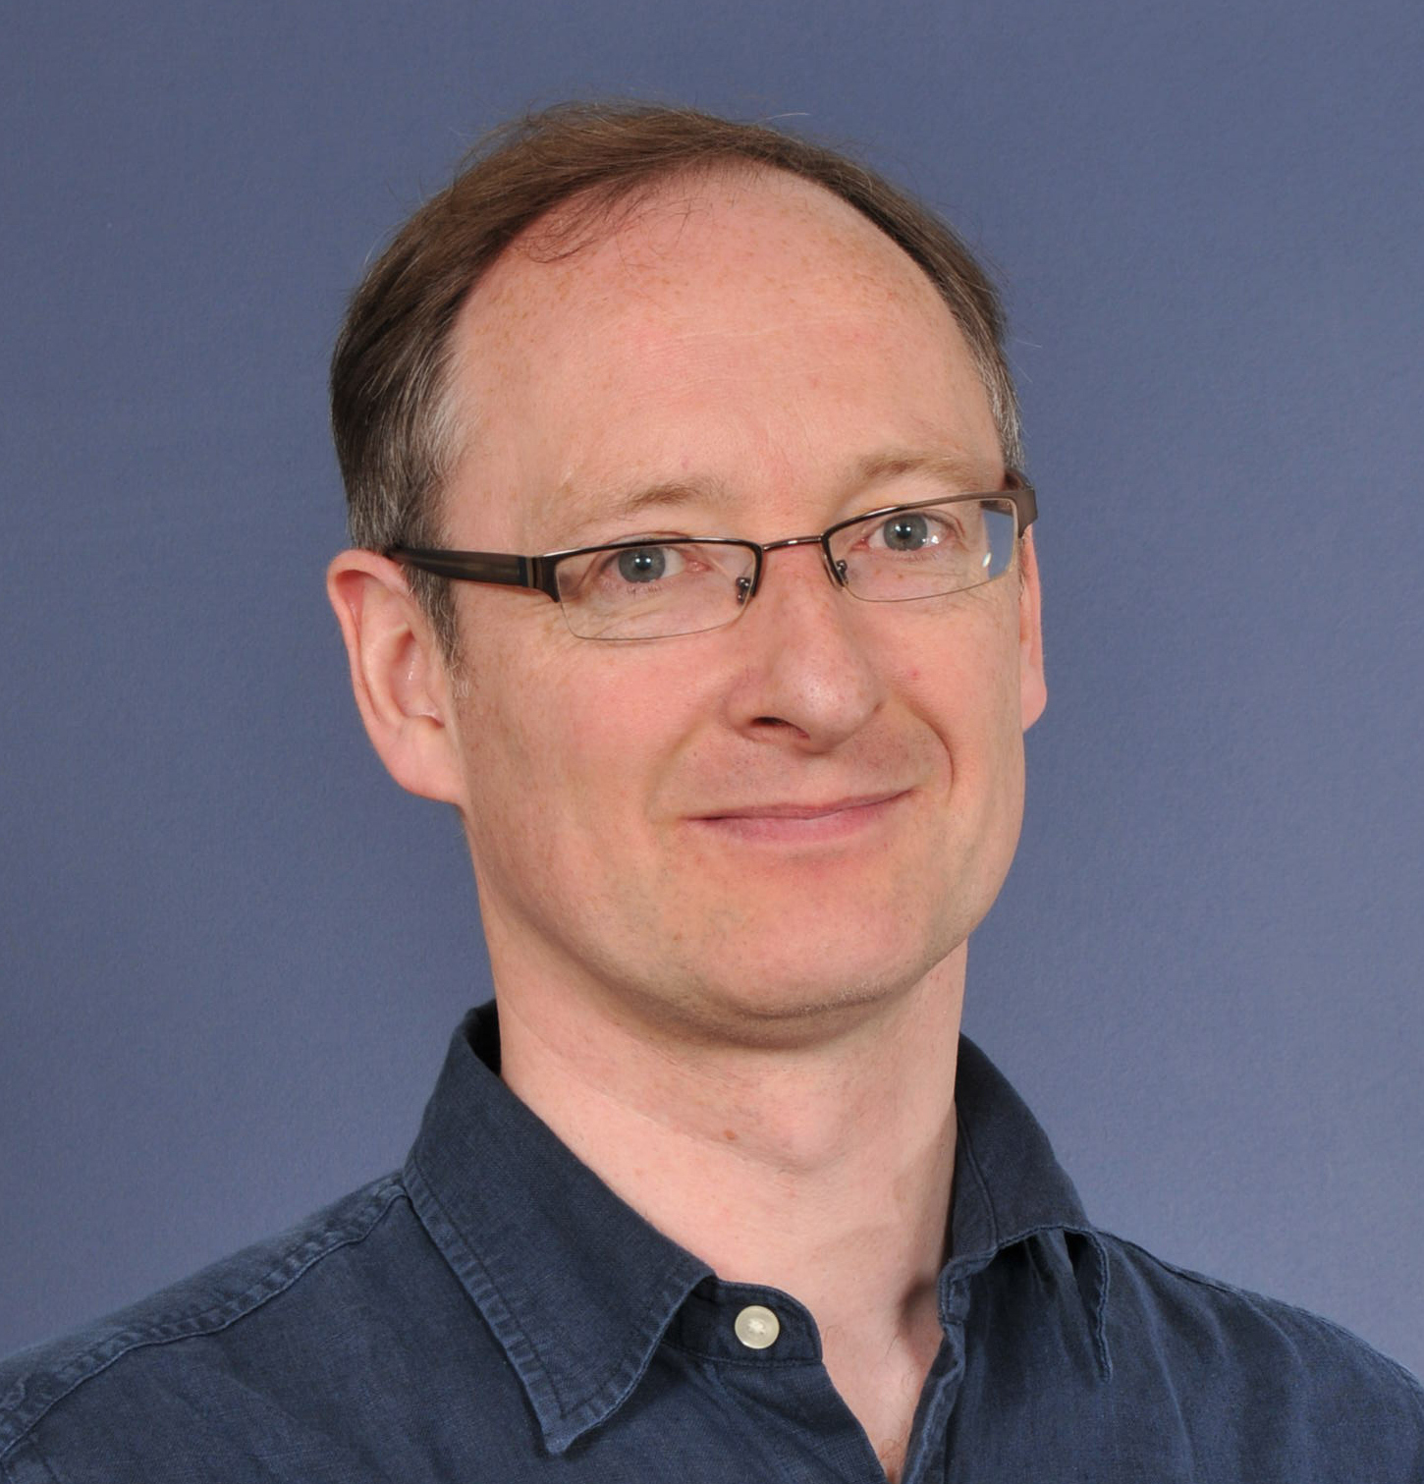
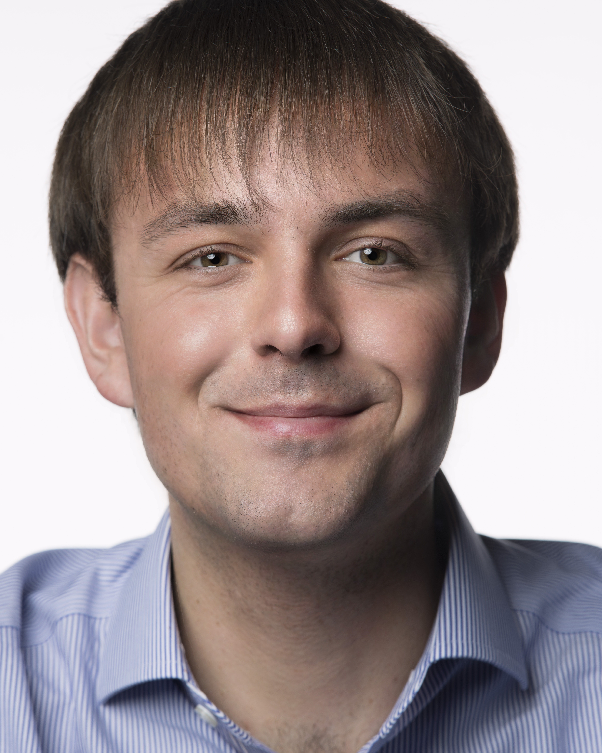
PHYS60022/70073 Data Science and Machine Learning for Physics
DSML 10/1/2024
“Machine Learning Data Science Physics” from Bing DALL-E
Tim Evans Patrick Dunne (Universe) (Particles)
Spring 2024

Slide 2

BLACKBOARD
All the current information is on the Blackboard site for this course.
Search for PHYS60022
PHYS60022/70073 - Data Science and Machine Learning for Physics (Spring 2023-2024)
https://bb.imperial.ac.uk/ultra/courses/_39636_1/cl/outline
These slides are only correct at the time of writing.

Slide 3

How the course is taught
The course is organised in ten sections, one per week.
Weeks 1 to 4 are run by Tim Evans
Weeks 5 to 10 are run by Patrick Dunne
One python notebook every week contains both the lecture material and the exercises for the week.
The students are intended to work through each section, each notebook over seven days.

Slide 4

Each week
Each week is broken down as follows:-
The DSML course week starts on Wednesdays at 09.00 (except last week, week 11) with a one-hour presentation from a lecturer in the computing lab.
The computer suite is booked for the course immediately after the lecture from 10.00-11.50 on Wednesdays.
Students to work together on the Jupyter notebook for that week.
Students should then work on the exercises in the rest of the notebook over the following four working days.
A feedback/presentation session with a lecturer on Mondays at 16.00 in a lecture theatre starting in week

Slide 5

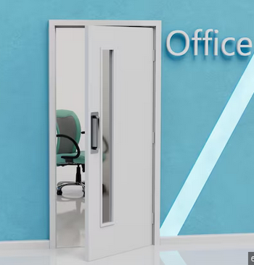
Additional Resources
The Ed discussion board on the Blackboard course site is the best way to ask questions.
An optional feedback exercise on Wednesday 28th February (week 8) held outside standard teaching hours in the afternoon from 14.00-16.00.
Optional, does not contribute to the final grade
Students will be given the opportunity to meet a marker and get feedback.
Office Hours. Two per week with the lecturer, see Blackboard for times and locations.

Slide 6
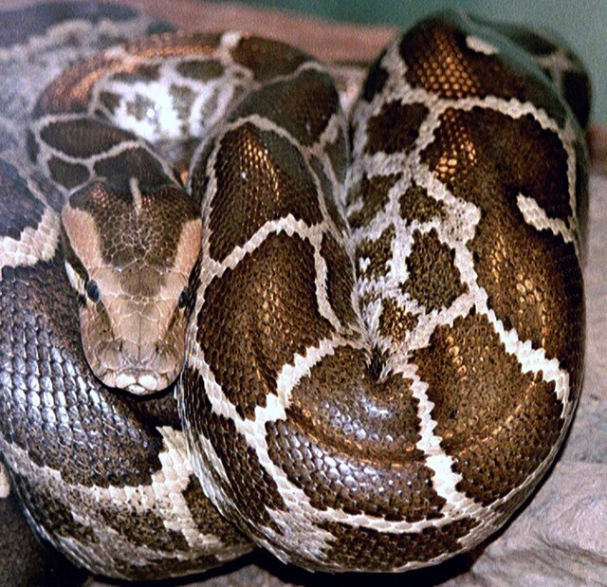

Computing Language Requirements
The course will use python.
We do not assume knowledge beyond that of seen in compulsory courses.
We will use the markdown language to write text in Jupyter notebooks.
Simple, learn what we need today
We use basic LaTeX in the text for equations.
Only basics, learn what we need today.

Slide 7
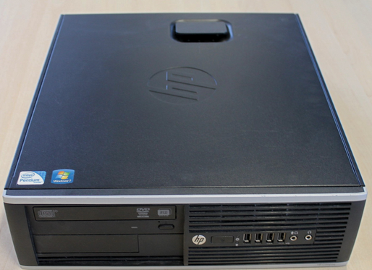
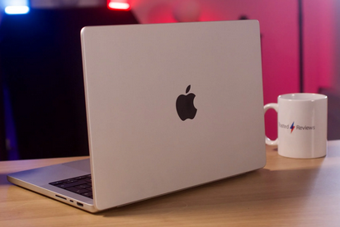
Hardware Requirements
Assessment will be on a PC from the Physics computer suite only.
Weekly work can be performed on the Physics lab PCs.
Laptops Not Needed
You are welcome to use your own machine for this course but we do not support any machine other than the PCs in the computer lab.

Slide 8

Bibliography
The Jupyter notebooks are the slides, notes and problem sheets for the course.
You can always use the "File" - "Download as" to save notebooks in another format (e.g. pdf)For
For statistics use notes from PHYS40005 Statistics and Measurement course (copy on DSML Blackboard).
We do not require any textbooks for the course but have three recommendations on the DSML Blackboard site
"The Hundred-Page Machine Learning Book“ (free)
"Hands on machine learning with Scikit-Learn, Keras and TensorFlow 3rd Edition" (£60).
"Introduction to Machine Learning with python" (£50)

Slide 9
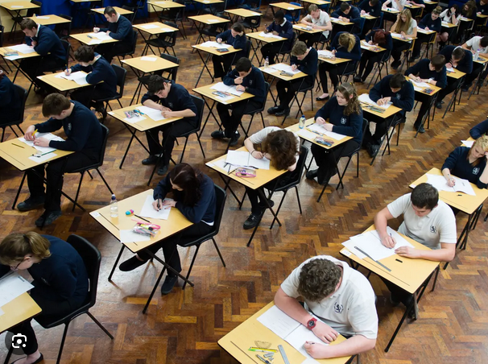
Assessment
The course is assessed on a single one-day practical exam is provisionally scheduled for 29th April 2024 (first day of term 3) but you should check your exam timetable.
In the exam student will complete tasks set out in a Jupyter notebook on a Physics PC in the Physics Computer suite
Much like the weekly exercises
Feedback test in week 8 is a shorter version.
The exam will be split into two parts.
Students with special exam arrangements should contact the lecturers asap.
No other work contributes to the final course mark.

